Slide 1



COMPREHENSIVE DROWSINESS DETECTION SYSTEM
Presented By,
Monisha V(811722104093)
Nishanthi V (811722104103)
Pooja P (811722104108)
Guided By,
Mr. A. Malarmannan M.E.,
DD/MM/YYYY

Slide 2
ABSTRACT
The "Comprehensive Drowsiness Detection and Alert Solution for Automotive Safety" addresses the growing concern of road accidents caused by driver fatigue, a factor contributing to approximately 20% of accidents globally. Ensuring driver alertness is crucial for mitigating risks and safeguarding lives.
This project proposes a robust, real-time monitoring system that combines computer vision and deep learning techniques to detect early signs of drowsiness and prevent accidents.
The system uses a live camera feed to capture the driver's facial features, focusing on eye movement and blink patterns.
Upon detecting drowsiness, the system triggers an audible alarm to immediately alert the driver.This non-intrusive approach ensures continuous monitoring without causing discomfort or distractions.
DD/MM/YYYY

Slide 3
OBJECTIVE
Real-Time Drowsiness Detection
Automated alert mechanism
Scalable and cost effective solution
DD/MM/YYYY

Slide 4
LITERATURE SURVEY
S.No. | Paper Title | Year | Remark
1 | Real-Time Driver Drowsiness Detection System Using Eye Aspect Ratio and Yawning | 2020 | Uses OpenCV and Dlib to monitor eye closure and yawning; lightweight and real-time capable
2 | Driver Drowsiness Detection System Based on Multi-Feature Fusion and Classification | 2021 | Combines EEG, eye blinking, and yawning features; uses machine learning for higher accuracy.
3 | Driver Fatigue Detection Based on Eye State Analysis and Head Movement | 2019 | Integrates head pose and eye status for improved robustness in natural driving conditions.
DD/MM/YYYY

Slide 5
LITERATURE SURVEY
S.No. | Paper Title | Year | Remark
4 | Deep Learning-Based Driver Drowsiness Detection System Using VGG16 Architecture | 2022 | Employs CNN-based model (VGG16) for facial feature extraction; achieves high accuracy.
5 | EEG-Based Drowsiness Detection System Using Deep Neural Networks | 2020 | Uses EEG signals processed through deep learning; suitable for clinical or lab settings.
6 | A Hybrid Drowsiness Detection System Using Computer Vision and Physiological Signals | 2021 | Fuses camera-based and physiological data (e.g., heart rate); achieves improved reliability.
DD/MM/YYYY

Slide 6
LITERATURE SURVEY
S.No. | Paper Title | Year | Remark
7 | Smartphone-Based Drowsiness Detection Using Accelerometer and Camera | 2022 | Leverages smartphone sensors; cost-effective and portable, ideal for consumer applications.
8 | An IoT-Based Real-Time Drowsiness Detection System Using Deep Learning | 2023 | Cloud-integrated solution with alert system; suitable for connected vehicle environments.
9 | Vision-Based Drowsiness Detection System for Autonomous Vehicles | 2022 | Focuses on application in autonomous driving; integrated with vehicle safety systems.
DD/MM/YYYY

Slide 7
EXISTING SYSTEM
1.Optalert Fatigue Monitoring System
Optalert employs infrared light to monitor eye movements and eyelid behavior, providing real-time, objective assessments of driver alertness. The system includes specialized glasses Bosch's system analyzes steering behavior and driving patterns, assessing fatigue levels by evaluating steering movements, trip duration, and turn signal usage. It provides visual alerts, such as a flashing coffee cup icon, to warn drivers of drowsiness and recommends taking a break.
2. Smart Eye Driver Monitoring System
Smart Eye's AI-based software analyzes eye gaze, head movement, body posture, and activities using in-car cameras to determine dangerous driving behaviors like distraction and drowsiness. The system is hardware-agnostic and does not store video footage, ensuring driver privacy.
3. VigilEye AI-Based Drowsiness Detection
VigilEye combines deep learning techniques with the OpenCV framework to process facial landmarks extracted from the driver's face. The system demonstrates high accuracy, sensitivity, and specificity in detecting drowsiness, making it suitable for real-time implementation.
DD/MM/YYYY

Slide 8
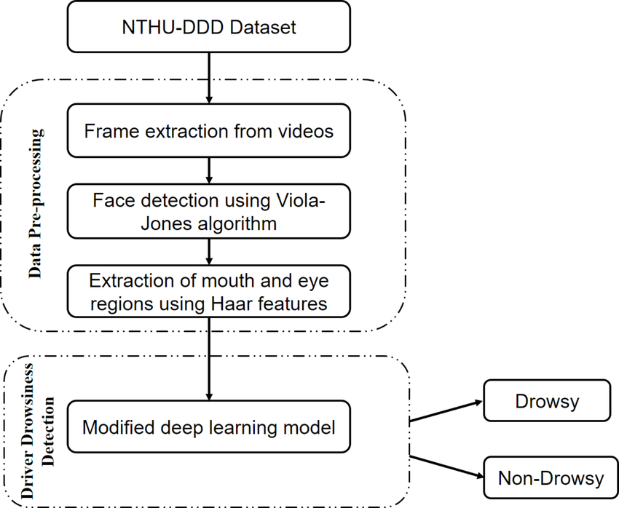
PROPOSED SYSTEM
DD/MM/YYYY

Slide 9
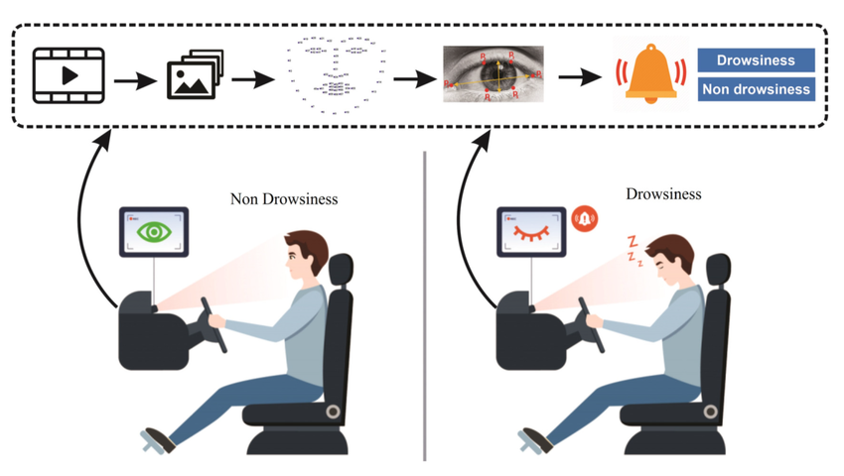
SYSTEM ARCHITECTURE
DD/MM/YYYY

Slide 10
MODULE 1 : Image Acquisition
Captures real-time video input using a webcam or camera.
Converts video frames into images for further processing.
Ensures consistent frame rate and image resolution.
Acts as the first step in the drowsiness detection pipeline.
DD/MM/YYYY

Slide 11
MODULE 2 : Face and Eye Detection Module
1.Uses Haar Cascade or deep learning models to detect face and eye regions.
2.Crops and isolates eyes from the detected face for precision.
3.Filters out irrelevant areas to reduce computation.
4.Supports real-time detection with high accuracy.
DD/MM/YYYY

Slide 12
MODULE 3 : Eye Aspect Ratio Calculation
Calculates the EAR using landmarks around the eyes.
Determines eye openness based on vertical and horizontal distances.
EAR is low when eyes are closed and high when open.
Outputs a continuous EAR value for each frame.
DD/MM/YYYY

Slide 13
MODULE 4 : Drowsiness Detection Module
1.Analyzes EAR trends over a sequence of frames.
2.Detects prolonged eye closure based on a threshold EAR value.
3.Sets a time window to confirm drowsiness (e.g., eyes closed > 2 seconds).
4.Triggers alert conditions when drowsiness is confirmed.
DD/MM/YYYY

Slide 14
MODULE 5 : Alert Generation
Activates audio or visual alerts when drowsiness is detected.
Logs the event for future analysis.
Can interface with vehicle systems for safety measures (e.g., slow down car).
Resets alert when eyes are open for a consistent period.
DD/MM/YYYY

Slide 15
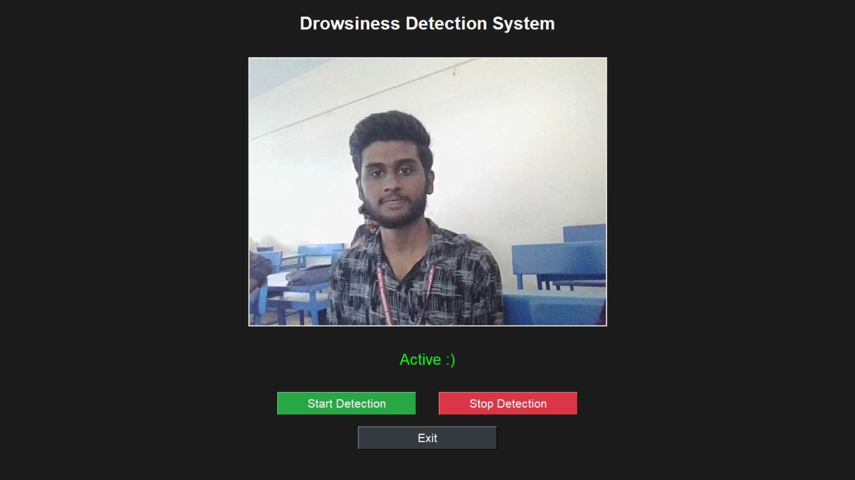
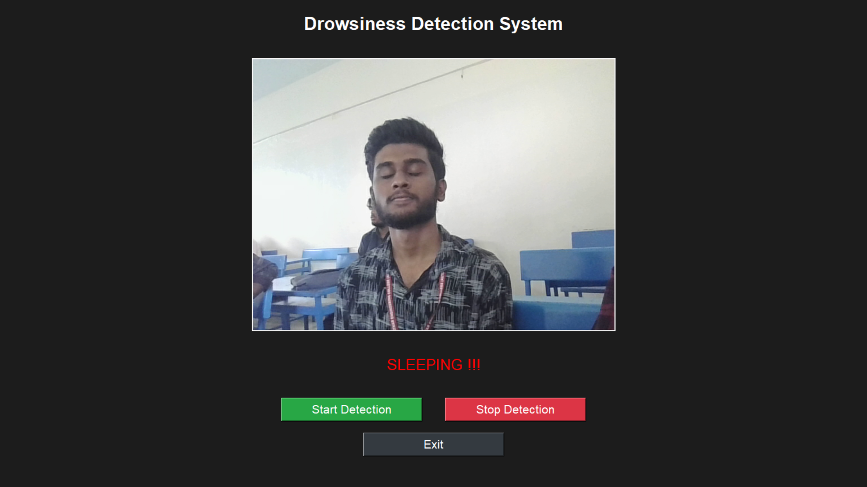
OUTPUT
DD/MM/YYYY

Slide 16
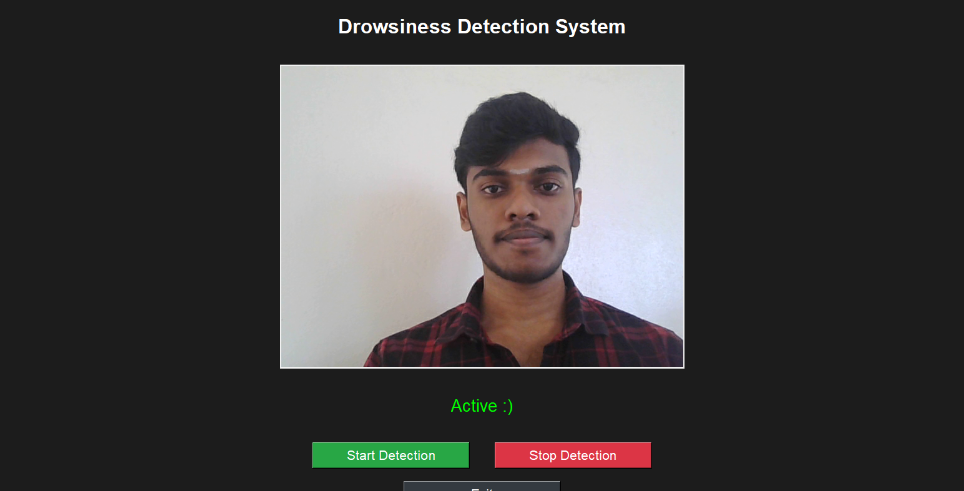
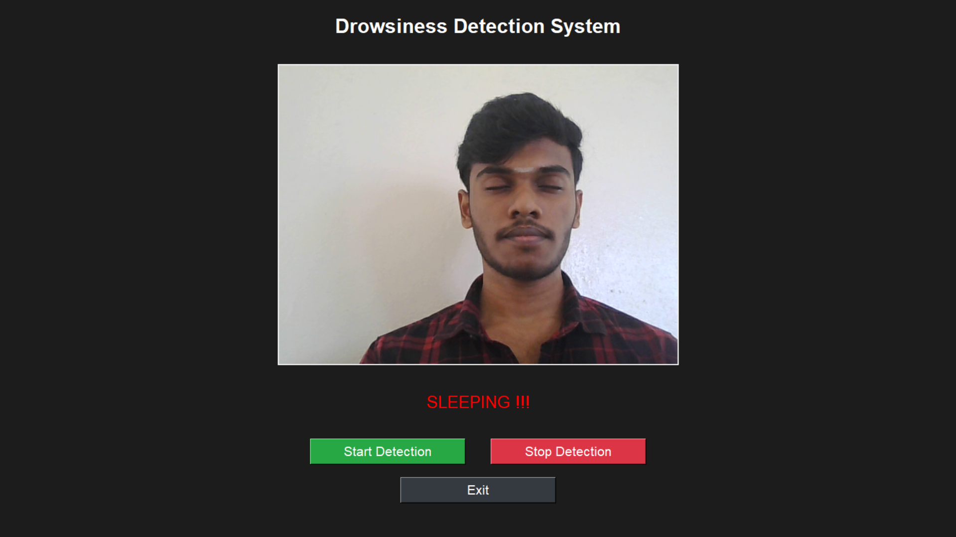
OUTPUT
DD/MM/YYYY

Slide 17
CONCLUSION & FUTURE ENHANCEMENT
The system effectively detects drowsiness using real-time facial cues and alerts the driver, enhancing road safety.
Integration of multi-sensor data (e.g., heart rate, steering behavior) can further improve accuracy and reduce false positives.
Cloud-based data logging and analytics can help monitor long-term driver behavior and fatigue patterns.
Future versions may incorporate AI-driven adaptive alert mechanisms personalized to individual driver profiles.
DD/MM/YYYY

Slide 18
REFERENCES
Use of the Hough Transformation to Detect Lines and Curves in Pictures by R. Duda and P.E. Hart explores the Hough transformation as a method for identifying features like lines and circles in images.
Face Detection in Color Images by R.L. Hsu, M. Abdel-Mottaleb, and A.K. Jain highlights techniques for face detection under varying conditions using color-based segmentation.
Open/Closed Eye Analysis for Drowsiness Detection by P.R. Tabrizi and R.A. Zoroofi investigates real-time detection of eye states to predict drowsiness
Driver Drowsiness Detection Using Neural Networks (2023, Suhana Nafais A) utilizes YOLOv3 CNN and LSTM networks for real-time detection of driver fatigue through facial landmarks and temporal features.
DD/MM/YYYY

Slide 19

DD/MM/YYYY

